Slide 1
Home automation

Slide 2
Business Case:
The aim of this project is to solve different problems that people face in their daily life.
It is designed to control devices via a smartphone using Wi-Fi as a protocol and a raspberry Pi as a private server.
All devices and sensors work as gateways to the Internet.
The server contains the recorded data for future extraction, the app is designed to automatically switch to a state that automatically controls the devices according to sensor readings.

Slide 3
Goal:
provides control of
lighting.
air conditioning.
Screens.
security system remotely.
, without the need to do these things manually.

Slide 4
Objectives:
Android-controlled Smart Home Automation should be able to control the home appliances wireless effectively and efficiently.
1-Controlling Home Appliances via Application (Switch and Voice Mode)
2-Secure Connection Channels between Application and Raspberry pi
3-Controlled by any device capable of Wi-Fi (Android, iOS, PC)
4- It provide the user with a report (daily, weakly, or monthly) of the Consumption of each device to help him to reduce the total consumption
5-It sends a notification to the user if there is a device still turned on for a long time, and the user can allow access to turn it off automatically.

Slide 5
Deliverable:
Device: Devices through which the application is able to control lighting, heat and security must be imported.
Design: The program code through which the devices are controlled will be written.
Coding “developing”: Installing appliances on home appliances that you control.
Integration: The hardware and code are integrated to be controlled through the program.

Slide 6
Scope Statement:
You can turn on or off your appliances in your home through the app.
Home automation is the ability to control your home without effort.
It sends notifications to the user if there is a device still turned on for a long time (like chargers), and the user can allow access to turn it off.

Slide 7
Risk Management:
Risk:
Risk Solving :
A delay in receiving the equipment.
High costs of devices.
Lack of home automation standards.
A shortage in the project budget.
Slow communication between devices and applications.
To avoid delays in receiving the devices, the two parties agree on a specific date for receiving the devices.
Increasing customs prices and tools used in the implementation of the project.
Checking the necessary standards and quality in the equipment used.
Development from the experience of programmers.

Slide 8
WBS:
Get away
Planning
Hardware
Coding
Testing
1,1
Requirements
1,2
Doing Study
about the
Project
1,3
Plan the Project
2,1
Hardware installation
2,2
Design
3,1 Coding the Functions in all Tasks
3,2 Test Devices
4,1 Test the Application

Slide 9
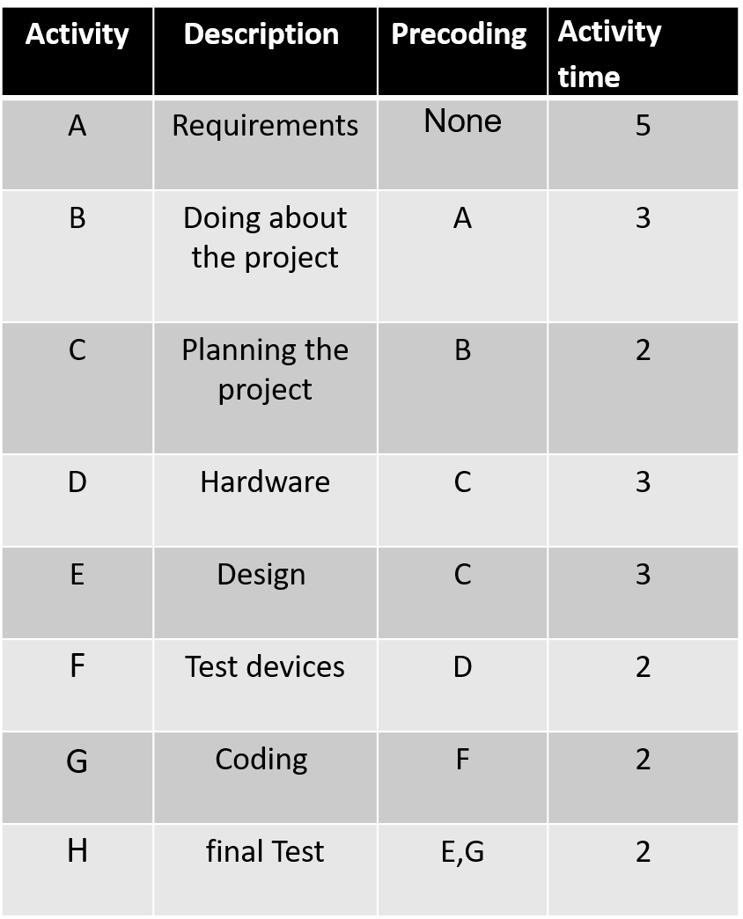

Slide 10
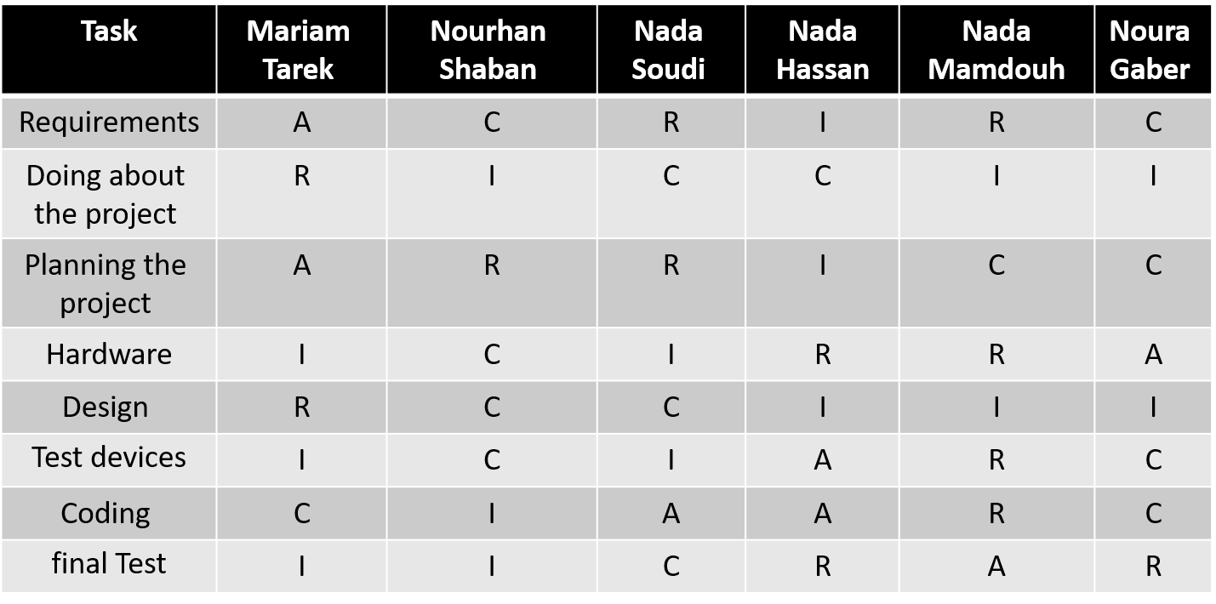
Responsibility Matrix:

Slide 11
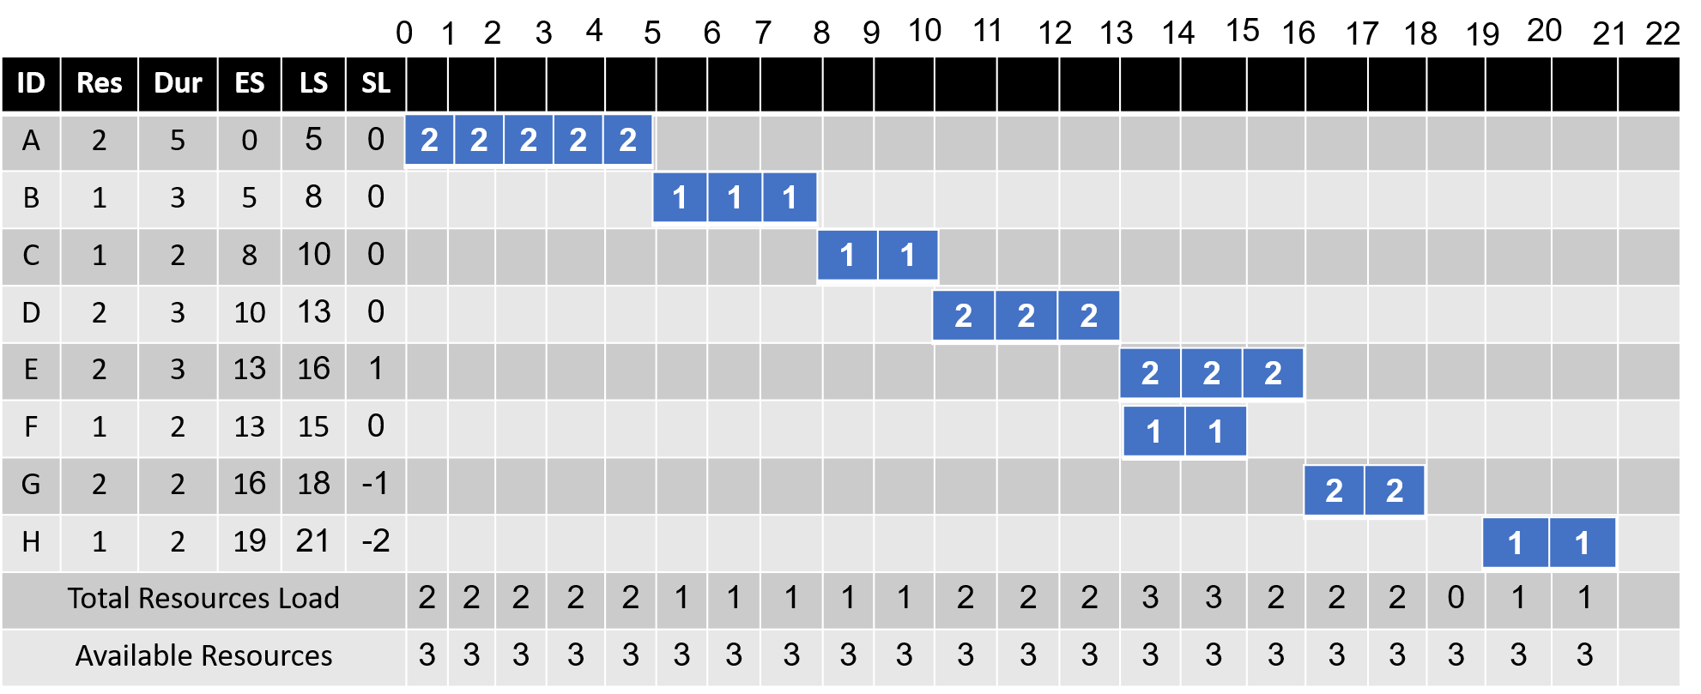
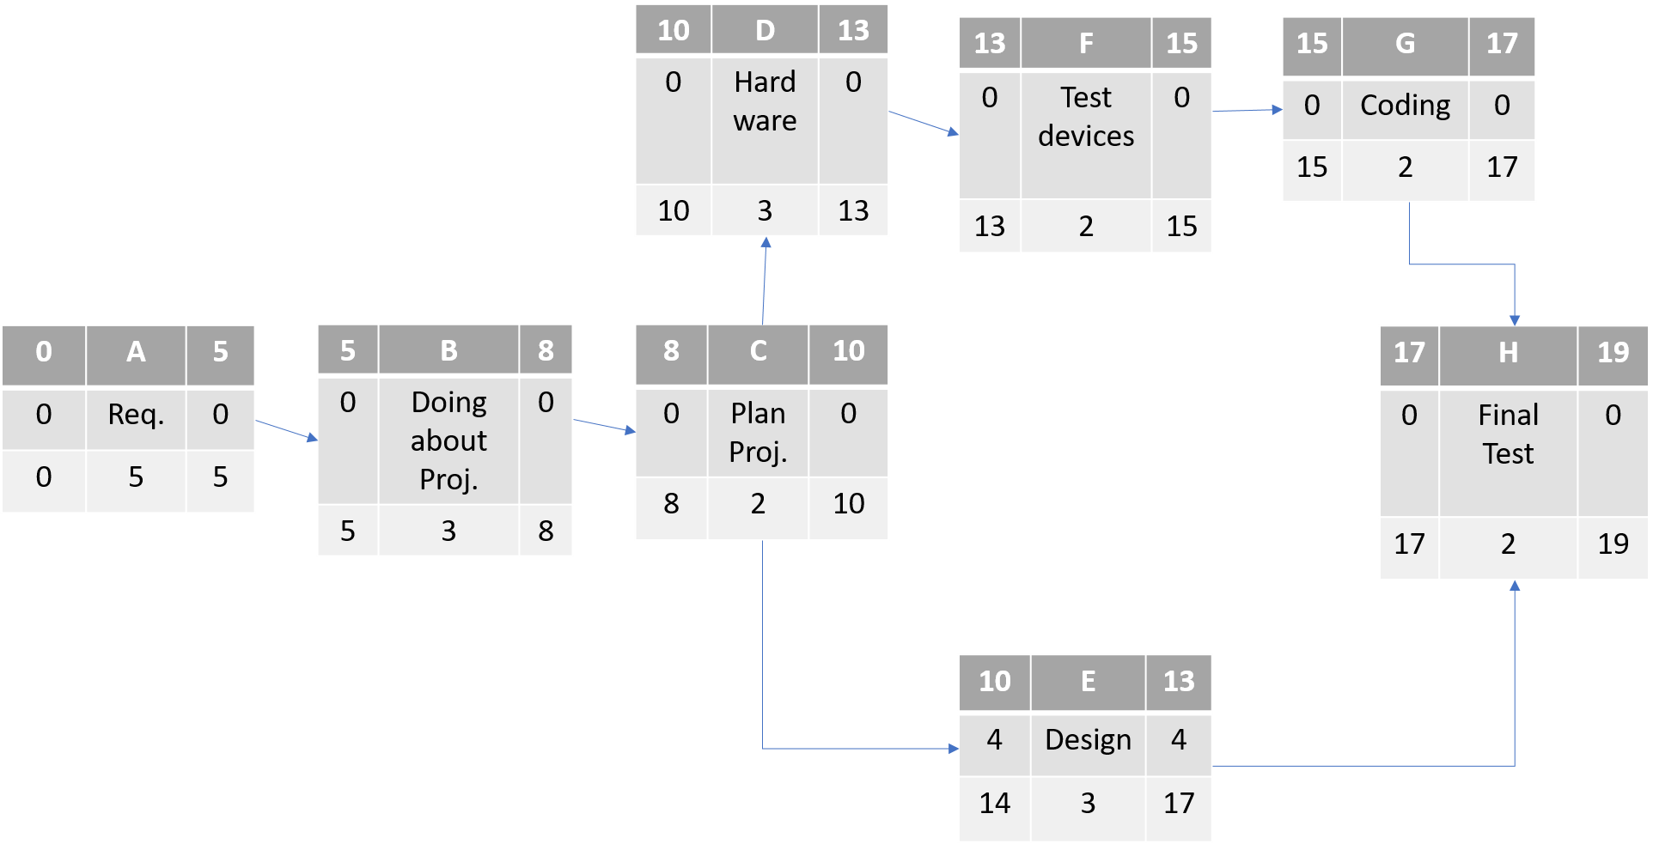
Project Network:

Slide 12
Gant chart
ID | Task | DUR | Start | finish | slak
A | Requirment | 5 | 1/1 | 5/2 | 0
B | doin project | 3 | 5/2 | 26/2 | 0
C | planning the project | 2 | 26/2 | 10/3 | 0
D | hardware | 3 | 10/3 | 1/4 | 0
E | design | 3 | 1/4 | 28/4 | 4
F | test devices | 2 | 28/4 | 12/5 | 0
G | coding | 2 | 12/5 | 26/5 | 0
H | final test | 2 | 26/5 | 10/6 | 0

Slide 13
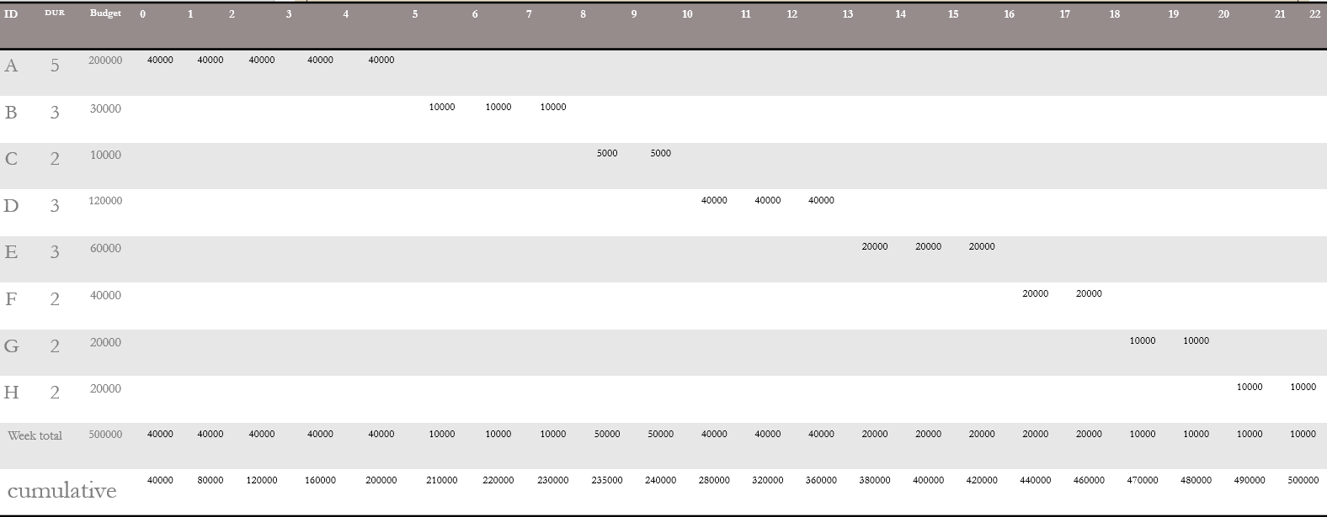
Time-Phased Budget

Slide 14
Cumulative Baseline Budget(PV)

Slide 15
Constraints:
Budget: around $500,000.
Time: 22 weeks.
Resources:
A-Team of electrical engineers.
A-Team of programmers.
Devices of the receiver.

Slide 16
Team Members:
Mariam Tarek
Nourhan Shaban
Nada Mamdouh
Nada Hassan
Nada Abdul Hamid
Noura Gaber

